Slide 1


Banking Dashboard Project
BY : MADHUR GAHANE

Slide 2

INTRODUCTION
Objective:
To explore, visualize, and analyze bank loan and transaction data using industry tools like Excel, Tableau, and Power BI.
Goal:
Create interactive dashboards that help in identifying key financial patterns, client insights, and decision-making indicators for financial institutions.

Slide 3

PROBLEM STATEMENT
The banking sector deals with huge amounts of client and loan data, which is difficult to analyze manually.
This project focuses on converting that raw data into clear, interactive dashboards to help banks track performance, understand customer behavior, and make data-driven decisions.

Slide 4

KPIS & INSIGHTS
Key Performance Indicators (KPIs):
Total Clients: 65.54K
Total Loan Amount: ₹751M Total Funded Amount: ₹733M Total Collection: ₹814.9M Average Interest Rate: 12.03%
Insights:
Home Loans were the most availed loan type. Hindu clients formed 75% of the dataset.
The majority of loans were 36-month terms. Highest active loan count: 36K
Most clients applied in 2018 (26K).

Slide 5
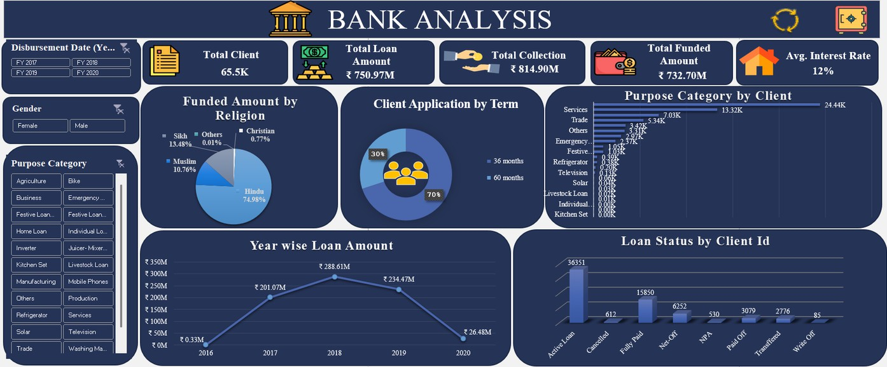
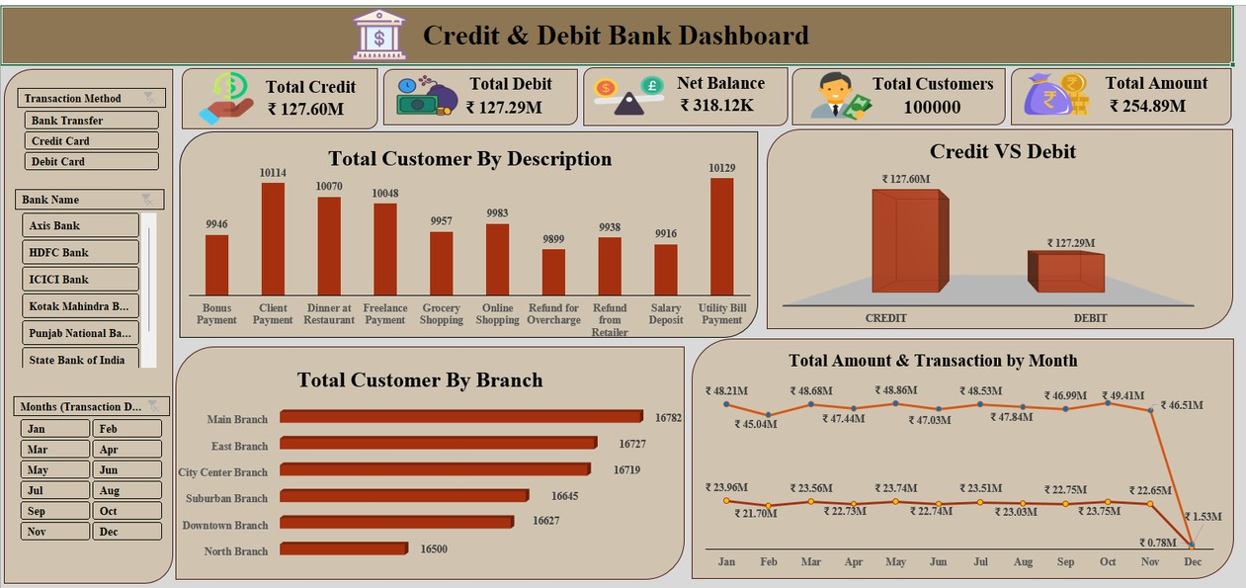
EXCEL DASHBOARD
Dashboard shows 68% clients chose 36- month loan term
Total loan disbursed is ₹31.35M with 2.5K clients.
Dashboard shows ₹127.60M credit,
₹127.29M debit, and 100K customers.
Main Branch leads with 16.78K customers; Dec shows sharp balance drop.

Slide 6
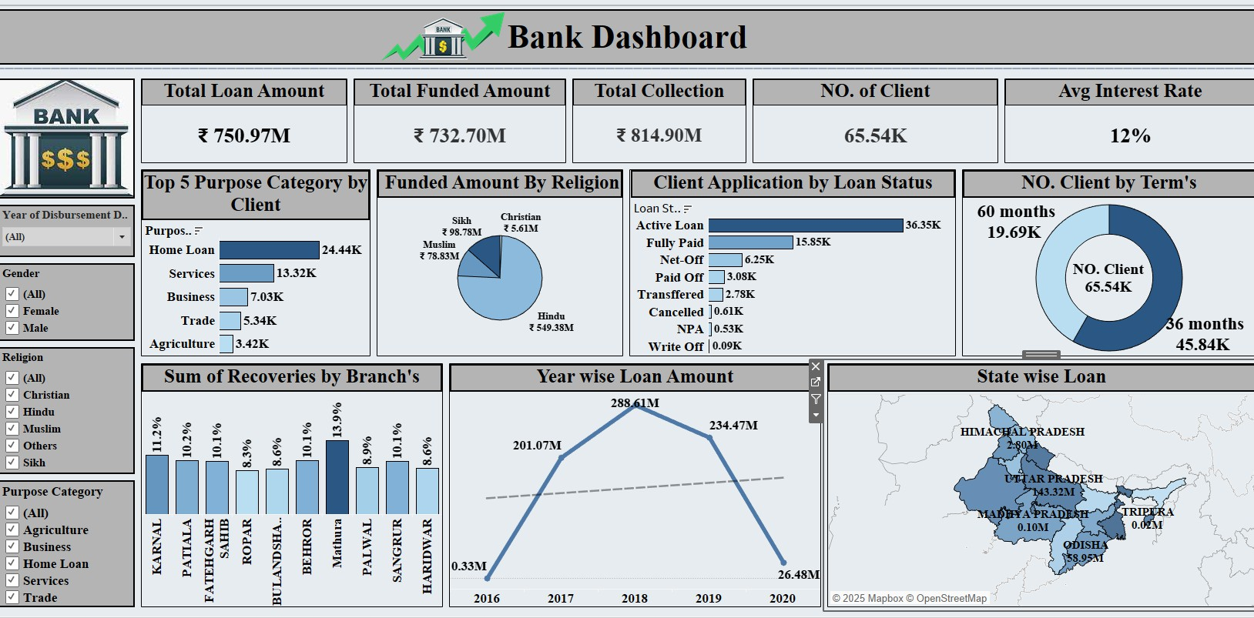
TABLEAU DASHBOARD
In this Tableau dashboard, total loan is ₹750.97M with 65.54K clients at 12% interest.
Most clients chose 36-month term and Home Loan is the top category.
1.82K clients have fully paid their loans.

Slide 7
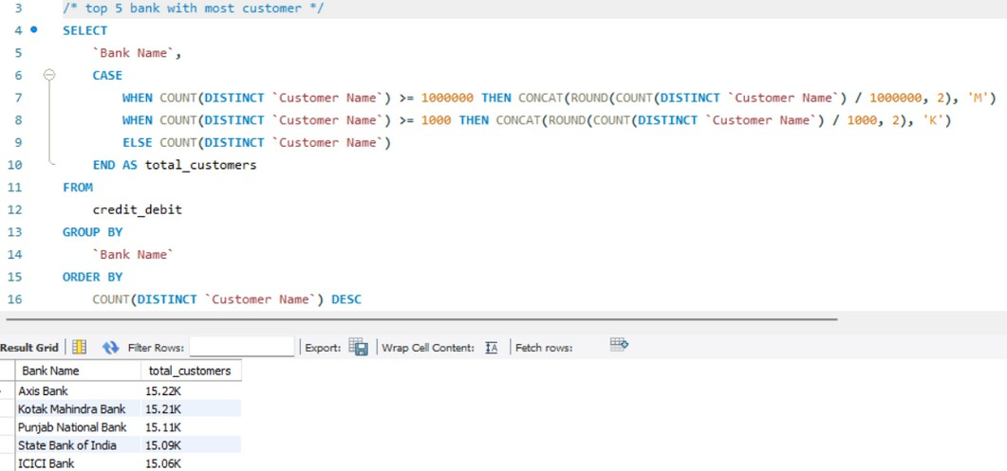
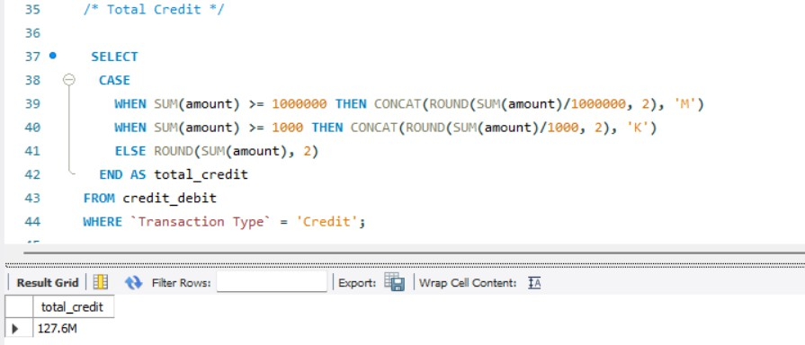
SQL QUERIES
📊 Displays Top 5 Banks with the Most Unique Customers from the credit_debit table.
🔁 Formats Customer Counts: Converts to 'K' (thousands) or 'M' (millions) for better readability using a CASE statement.
💰 Calculates total credit amount from all transactions.
🔢 Formats the sum in 'K' or 'M' for easier understanding.

Slide 8
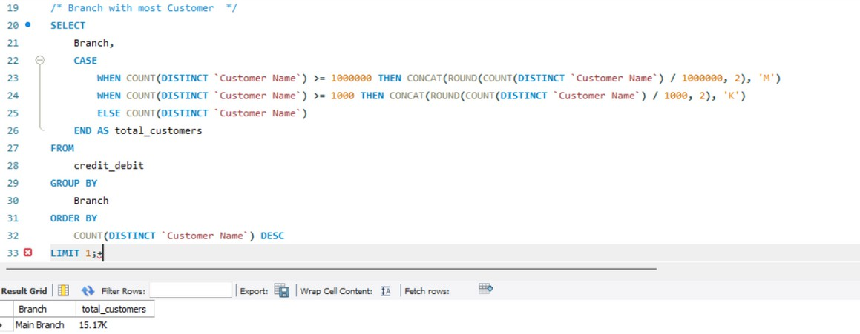
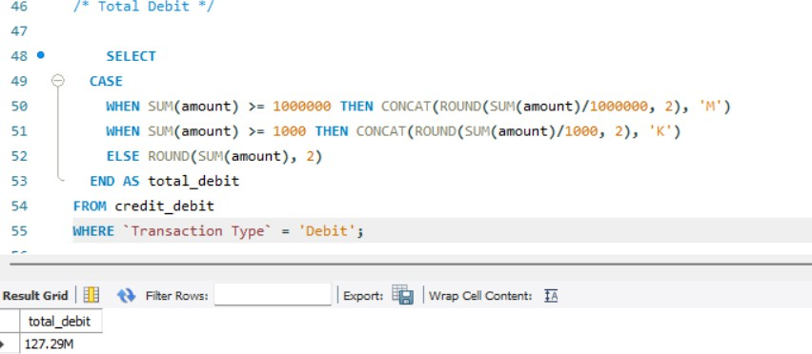
SQL QUERIES
🏢 Finds the branch with the highest number of unique customers.
🔢 Displays the customer count in 'K' or 'M' format.
💸 Calculates total debit amount from all debit transactions.
🔢 Displays the value in 'K' or 'M' format for clarity.

Slide 9
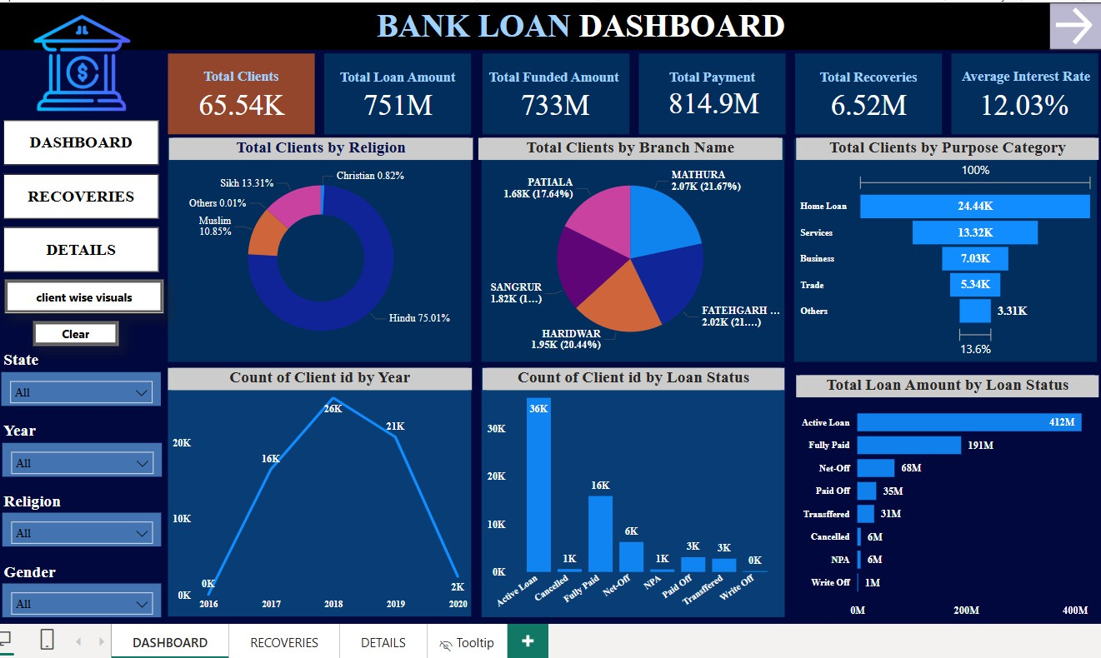
POWER BI DASHBOARD
The average interest rate is 12.03%, and total recoveries stand at ₹6.52M.
Home Loan is the top purpose category with 24.44K clients.
Patiala branch has the highest number of clients at 1.8K.

Slide 10

PROJECT SUMMARY
Domain: Banking Analytics – visualizing client and loan data Problem: Raw banking data is hard to interpret manually Tools Used: Excel, Tableau, Power BI, SQL
Built: Dashboards showing KPIs, loan trends, client insights Challenges: Data cleaning, tool learning, visual selection Learnings: Gained skills in visualization, SQL, storytelling Outcome: Clear dashboards for better decision-making
Mar
Head

Slide 11

THANK YOU!

